Slide 1
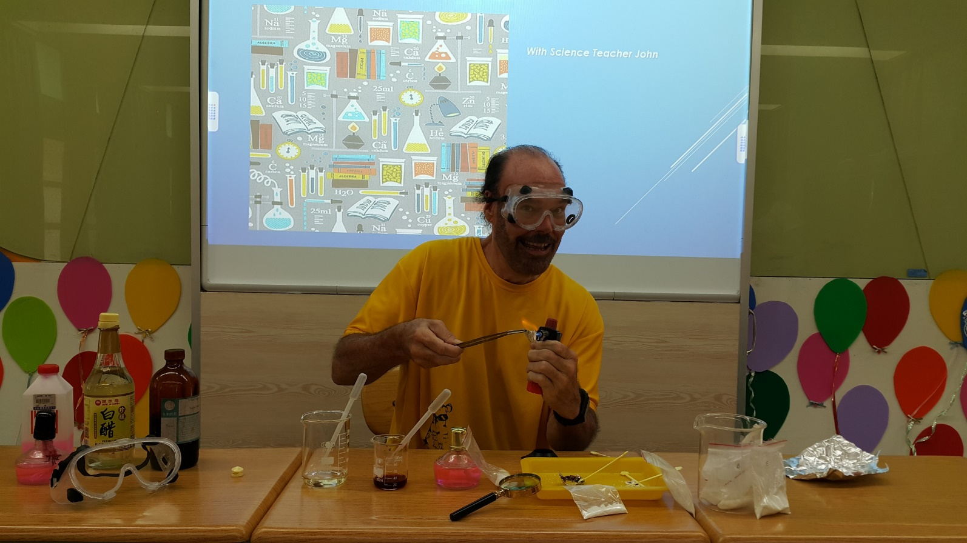
Unknown Substances
With Science Teacher John

Slide 2
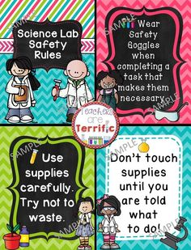
Rules
Keep it simple

Slide 3
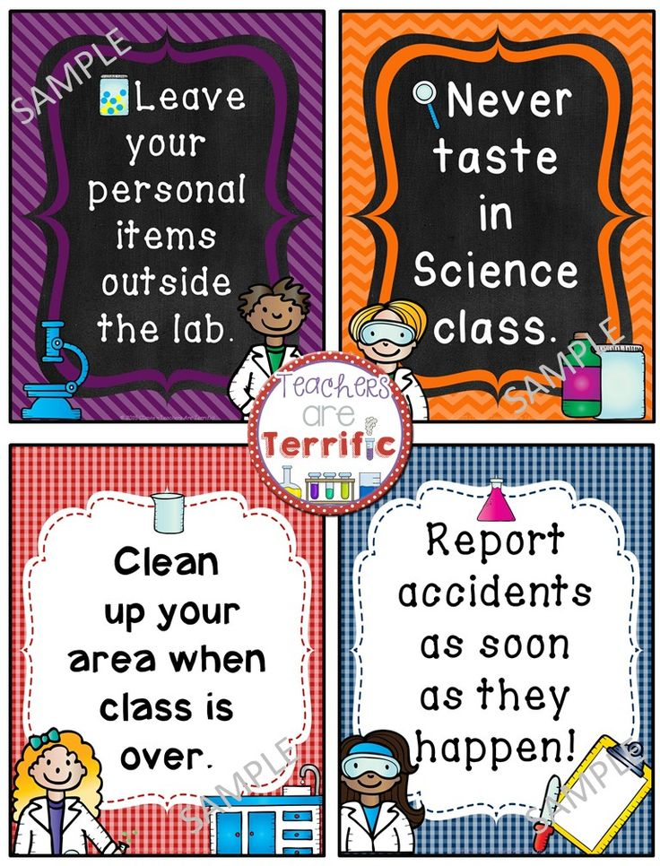
Rules
No playing
Everything off the desk/Chair in
Report accidents to teacher
Don’t waste supplies
Keep area clean
Team points for speaking English
Team points for writing on data sheet

Slide 4
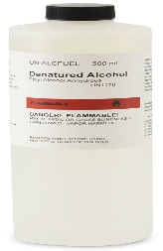
Vocabulary
Alcohol

Slide 5
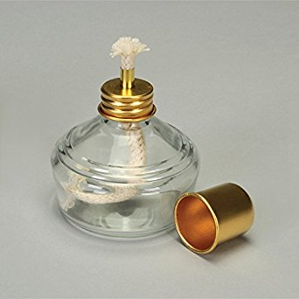
Alcohol Lamp

Slide 6
Stirrers

Slide 7
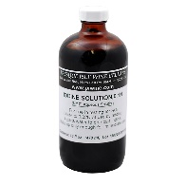
Iodine

Slide 8
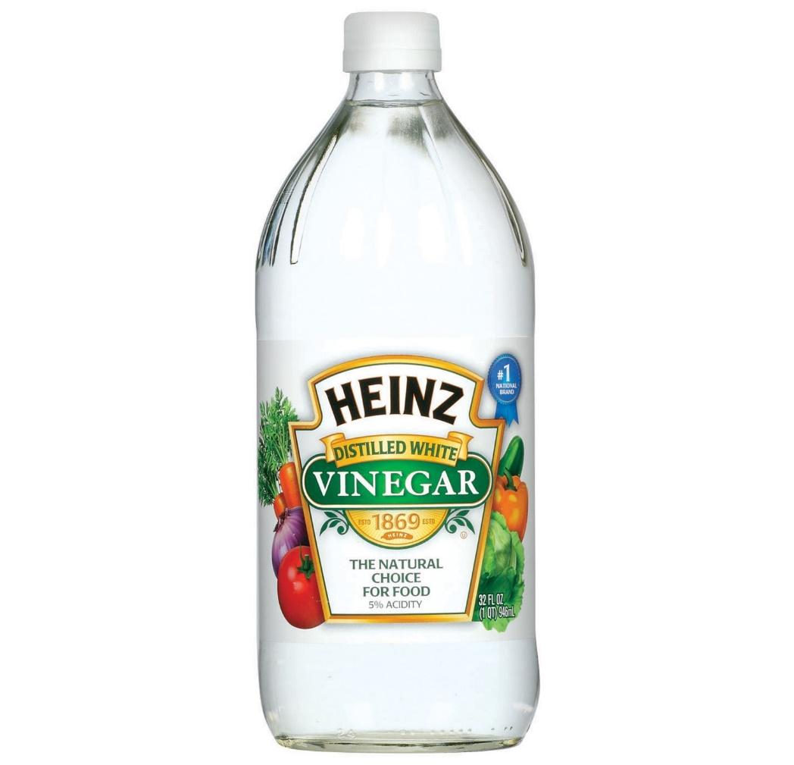
Vinegar or Acid

Slide 9
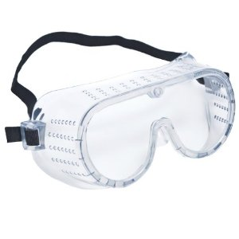
Safety Goggles

Slide 10
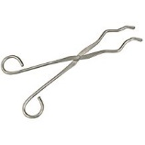
Tongs

Slide 11
Hand Lens

Slide 12
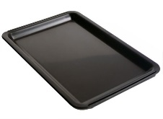
Tray

Slide 13
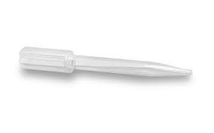
Eyedropper

Slide 14
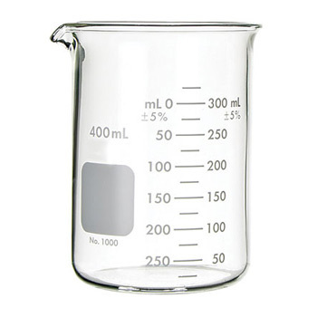
Beaker

Slide 15
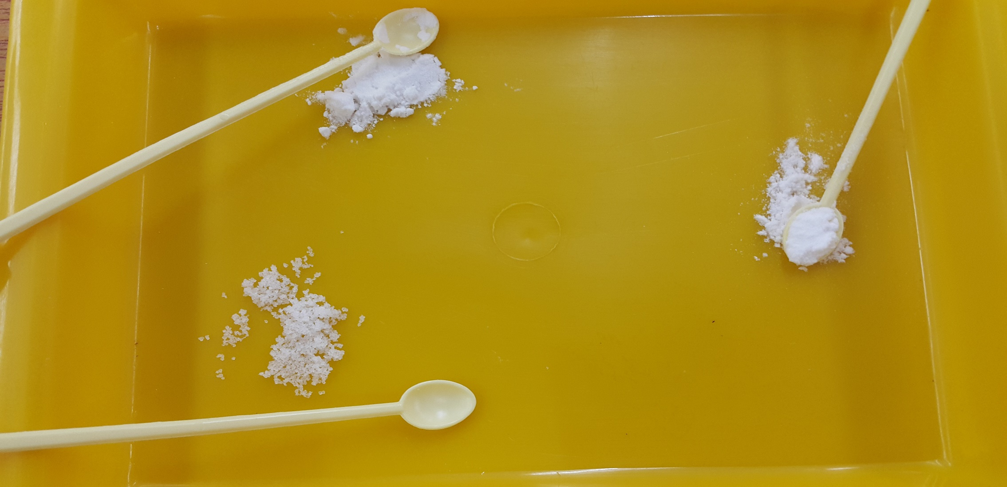

Slide 16
Contaminate 污染
Do not contaminate
the substances

Slide 17
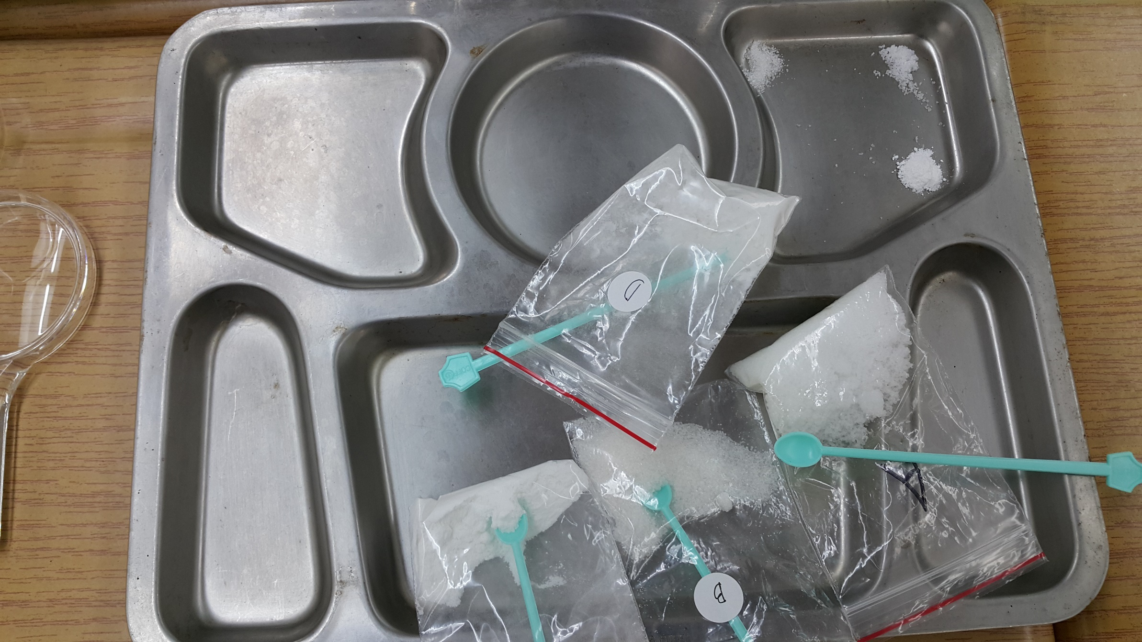

Slide 18
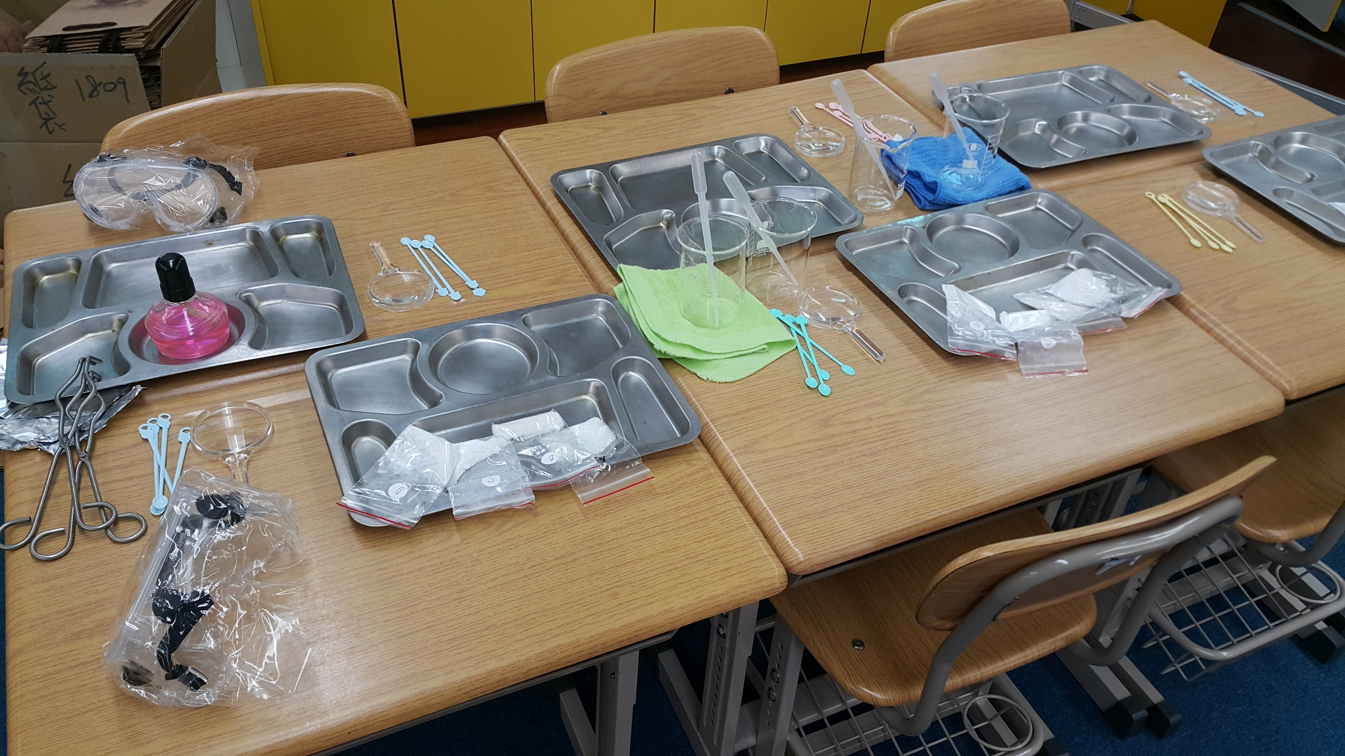

Slide 19
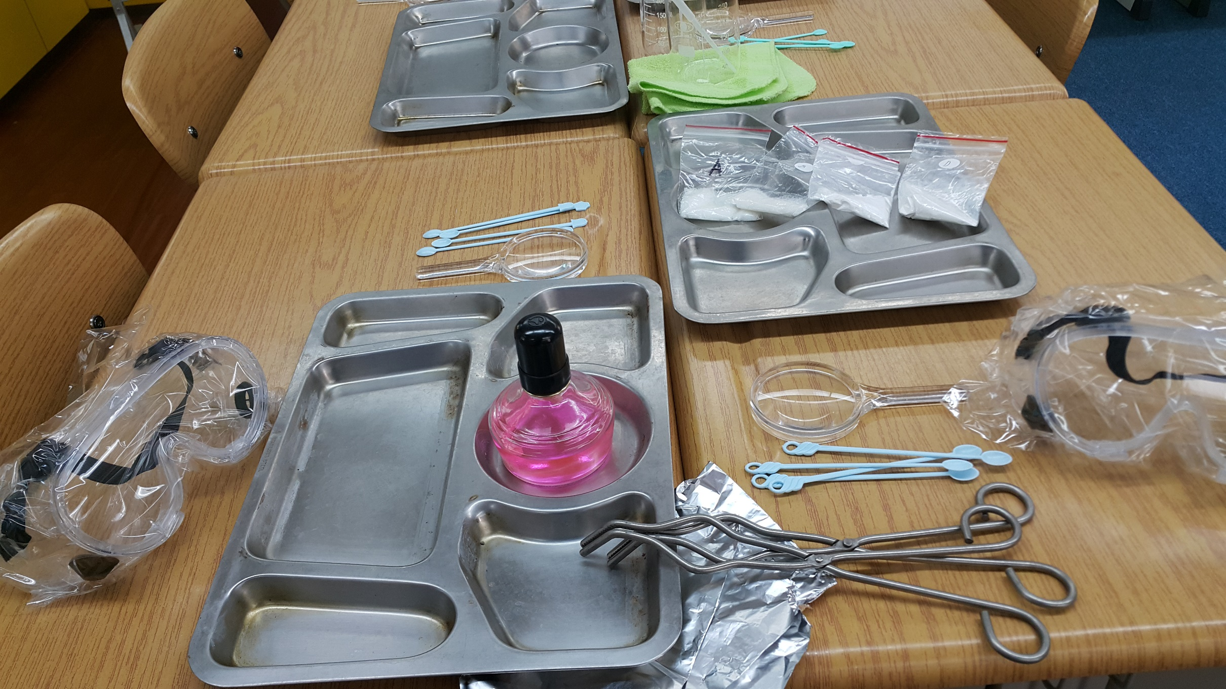

Slide 20
Got it?
Now let’s play a game!
Boys against the girls
&
Against Teacher John

Slide 22
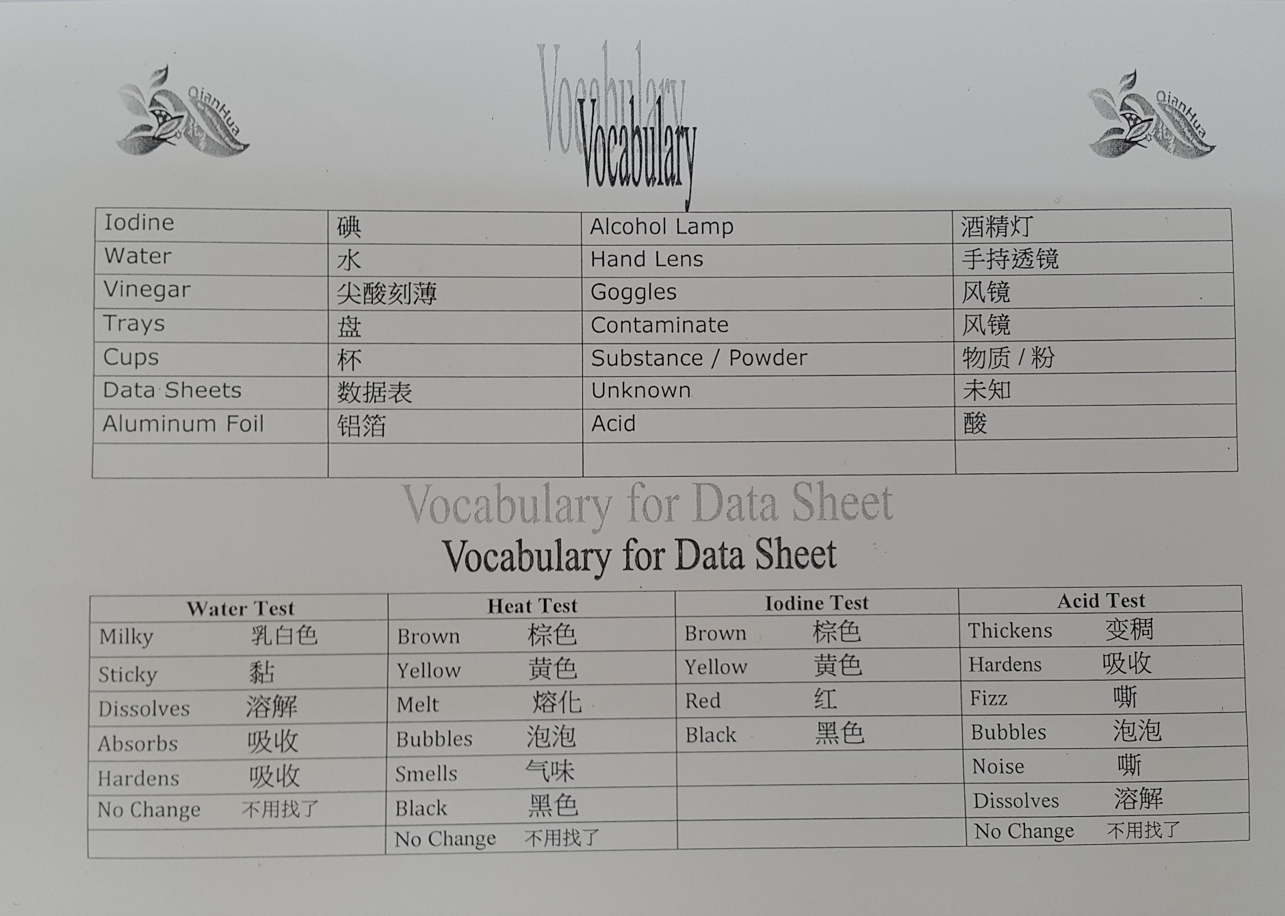

Slide 23
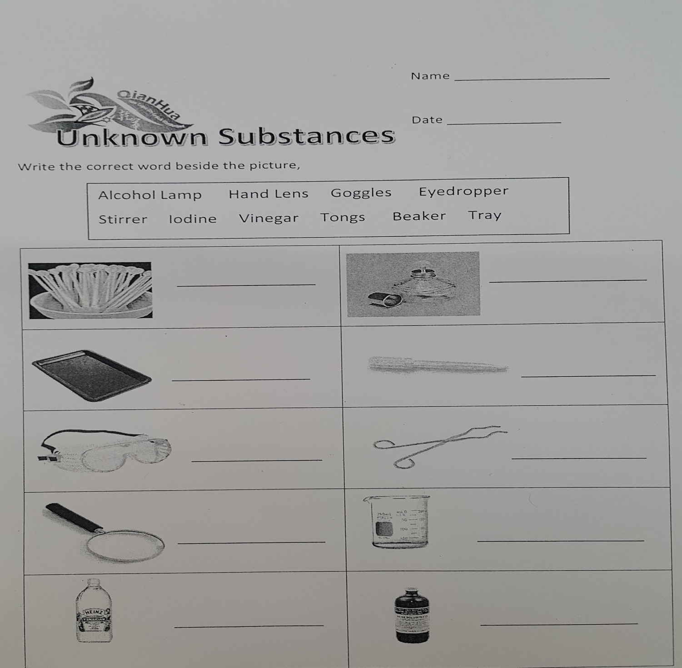

Slide 24
Lesson 1 | Lesson 2 | Lesson 3 | Lesson 4
Power Point | Trays (6) | Trays (6) | Trays (6)
Flash Card Game | Powders 2 x (4) | Powders 2 x (4) | Powders 2 x (4)
Orientation | Iodine & eyedropper | Vinegar & eyedropper | Iodine & Vinegar Alcohol Lamp
Demonstration | Hand Lenses | Alcohol Lamp | Tongs & Foil
 | Stirrers (24) | Stirrers (24) | Stirrers (24)
 | Hand Towel 1 | Hand Towel 1 | Hand Towel 1
 |  | Goggles (3) | Goggles (3)

