Slide 1
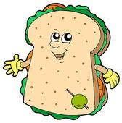
Sandwiches are beautiful

Slide 2
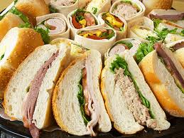
Sandwiches are fine

Slide 3
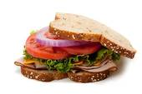
I like sandwiches

Slide 4
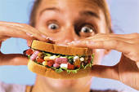
I eat them all the time!

Slide 5
I eat them for my supper
And I eat them for my lunch

Slide 6
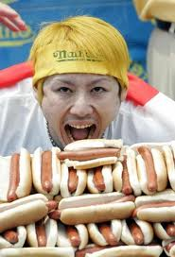
If I had 100 sandwiches I’d eat them all at once!

Slide 7
Sandwiches are beautiful, Sandwiches are fine -
I like sandwiches, I eat them all the time.

Slide 8
I eat them for my supper and I eat them for my lunch;
If I had a hundred sandwiches, I'd eat them all at once!

Slide 9
Sandwiches are beautiful,
Sandwiches are fine –
I like sandwiches, I eat them all the time.
I eat them for my supper
and I eat them for my lunch;
If I had a hundred sandwiches,
I'd eat them all at once!

Slide 10
Well a sandwich may be
beef or pork or chicken on a bun,
Eating lots of sandwiches can be so very fun.
I eat them in sun or rain, I eat them in a storm;
If the teacher’s not looking,
I’ll eat them in the dorm!

