Slide 1
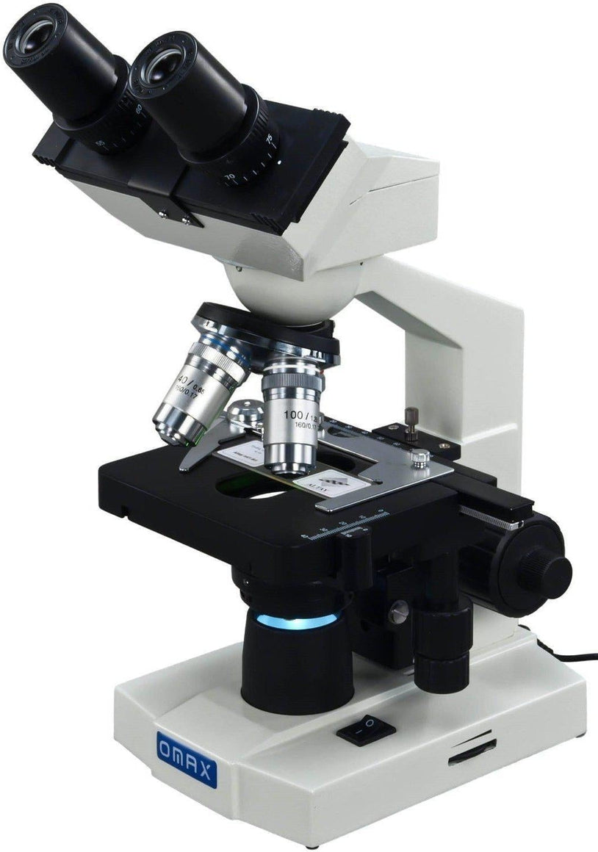
Science using
a microscope.
Created by Teacher John

Slide 2
eyepiece
Let’s learn the parts.
arm
objectives
stage
fine focus
light
course focus
lamp control

