Slide 1
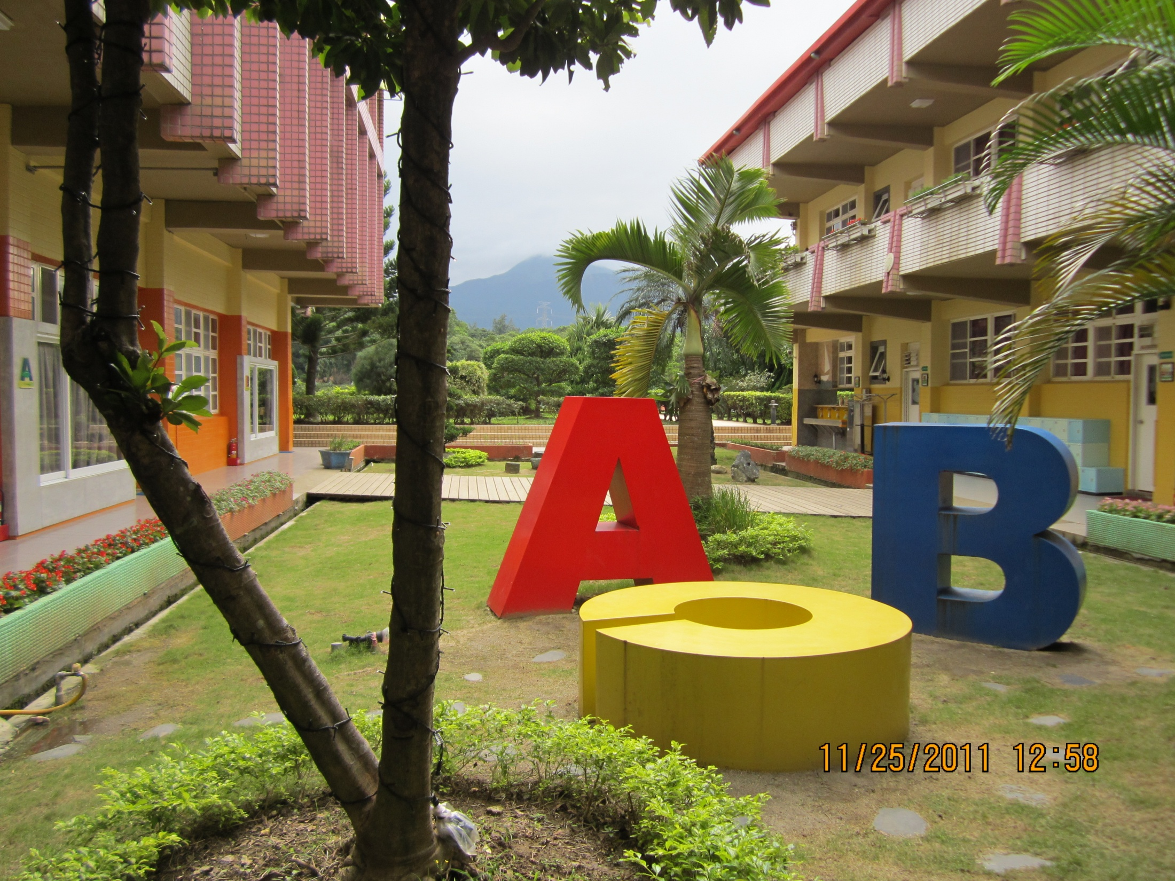
English Wonderland Qianhua
Teacher John Strain

Slide 2
Uniqueness of Camp Teaching
Students have very limited English skills
Lessons need to be fun and exciting
Students need to take some English knowledge - out the door
All this in 4 lessons

Slide 3
Goals
Give students confidence
Make learning English fun
Send them out the door with English
Encourage future study
How do you know if you met your goals?

Slide 4
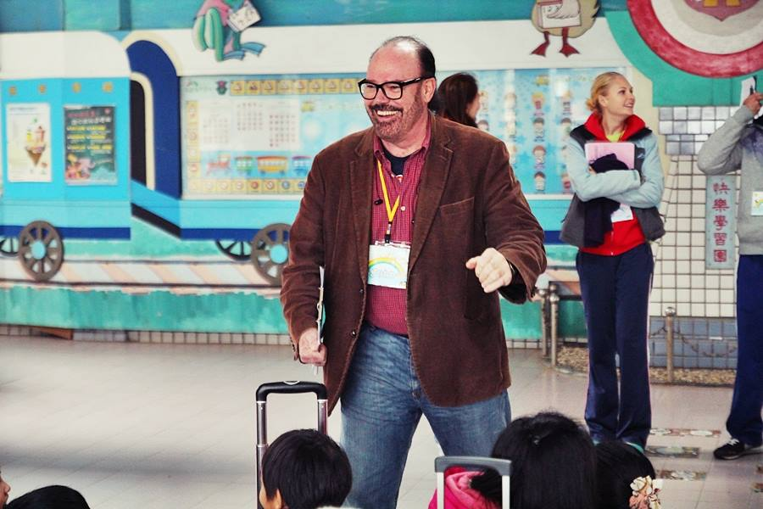
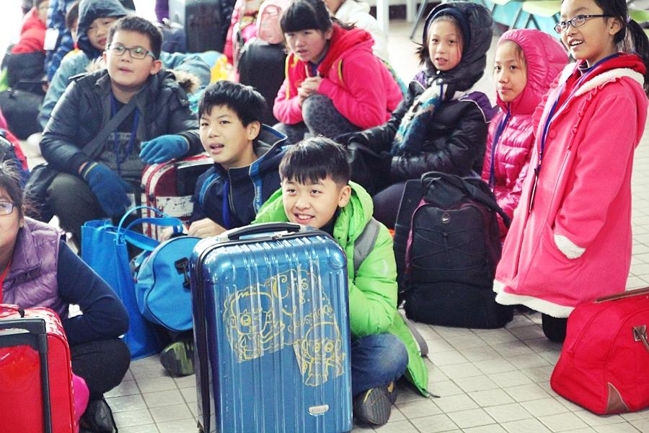
Our Camp
Introduction

Slide 5
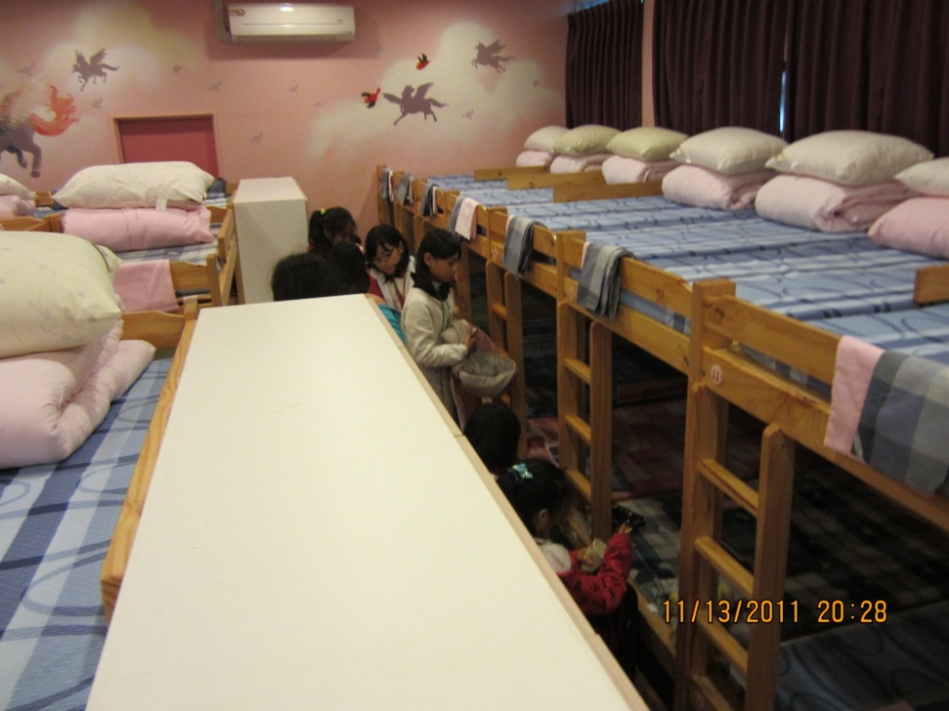
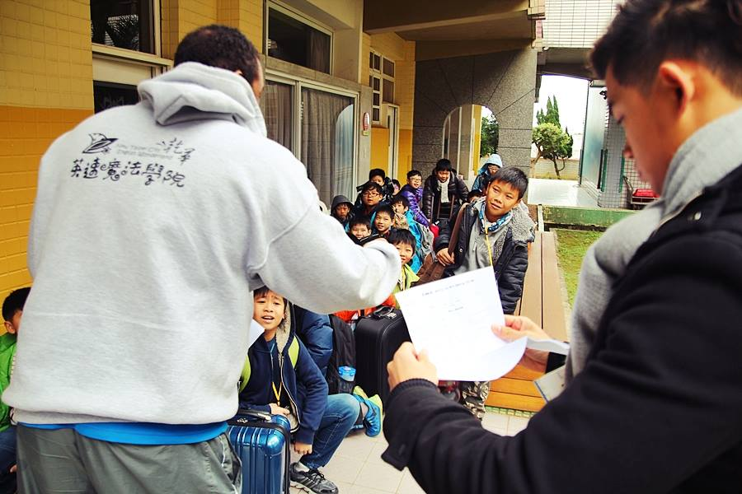
Locker and Dorms

Slide 6
Orientation
Rules
Behavior Plan
Team Cheer

Slide 7
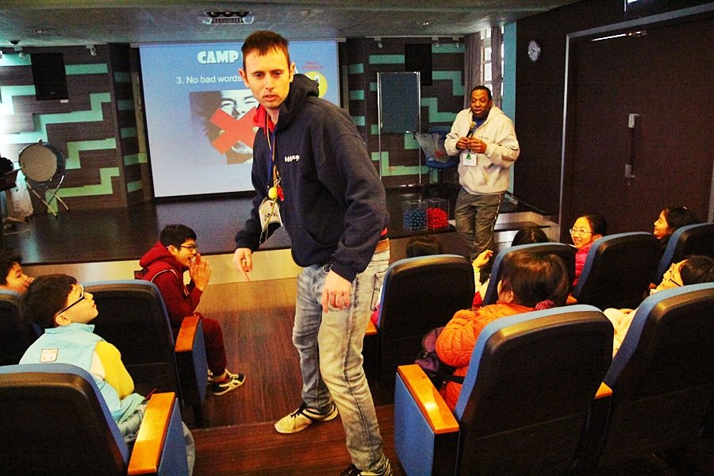
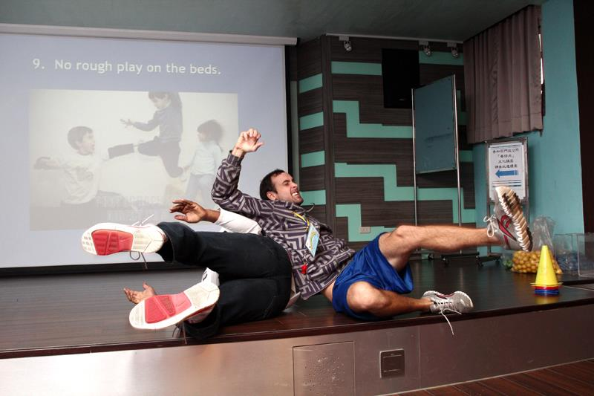
Rules

Slide 8
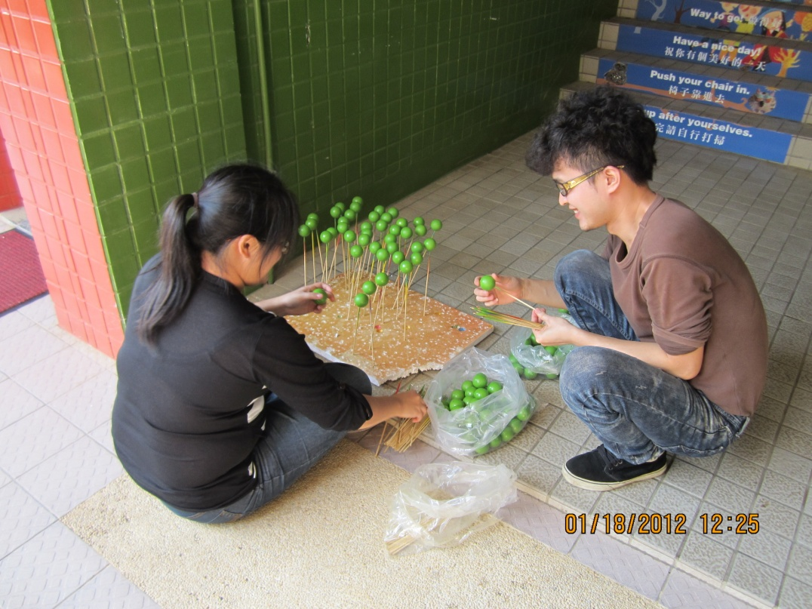

Slide 9
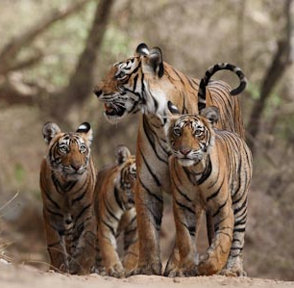
Team Cheer
Tigers - Tigers Slash – Slash Bite!

Slide 10
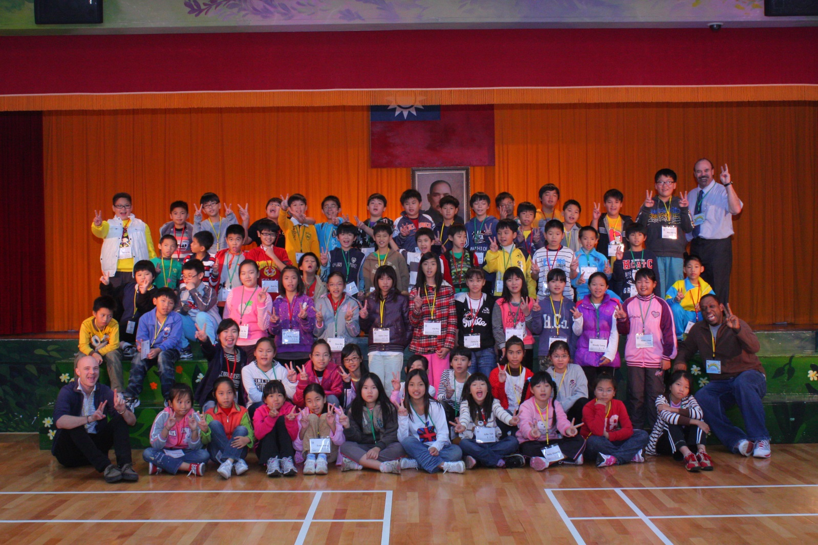
Photos

Slide 12
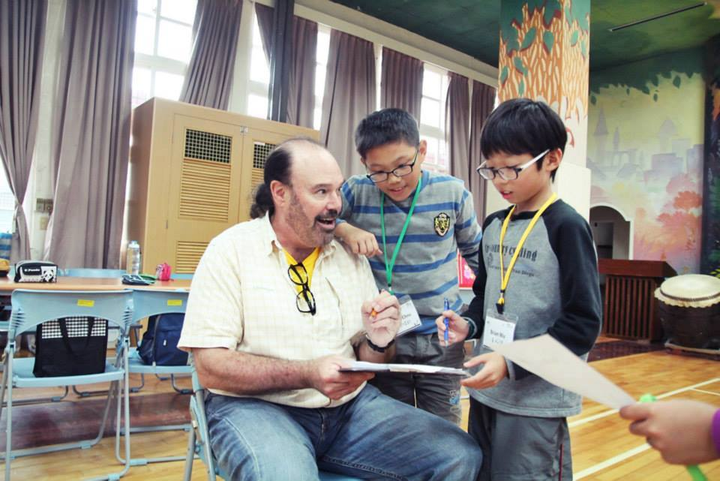
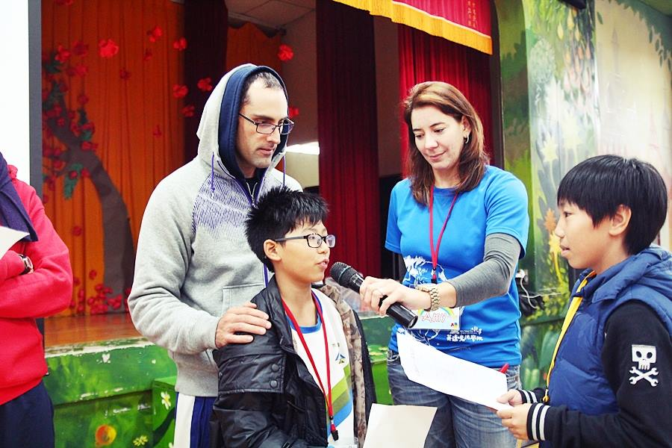
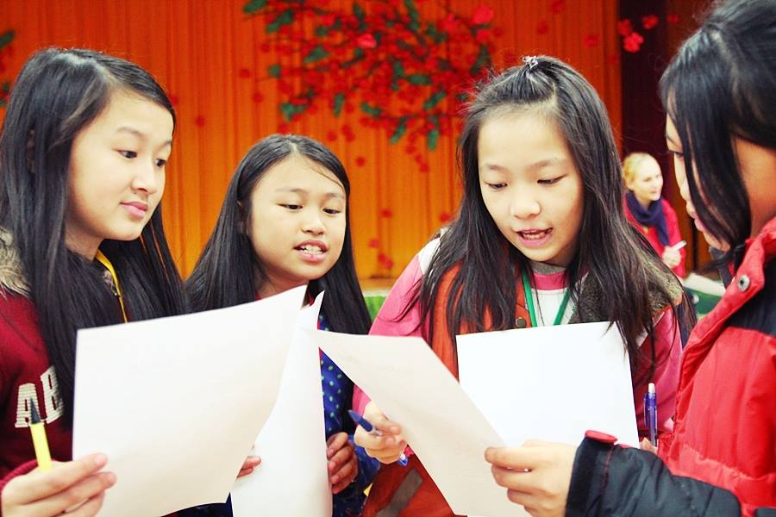

Slide 13
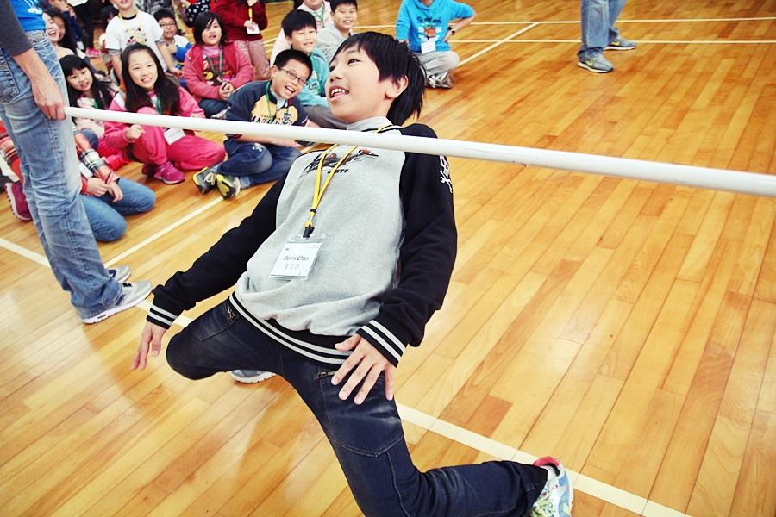
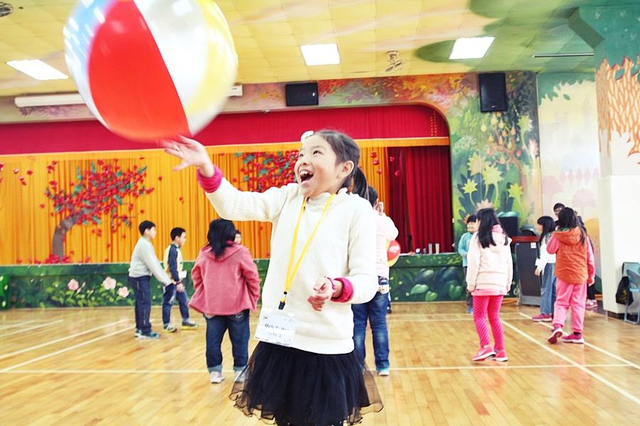
Activities

Slide 14
Meal Song

Slide 15
Lunch

Slide 16
My 4 Classes – No Bullies
Class
Teach needed English phrases
Play a game using the phrases
Drama – On the Bus
Drama – Glasses
Demonstrate Skit
Make glasses & recite skit lines
Do Skit – Use Rubric to score
Skit – On the Playground
Homework on Website

Slide 17
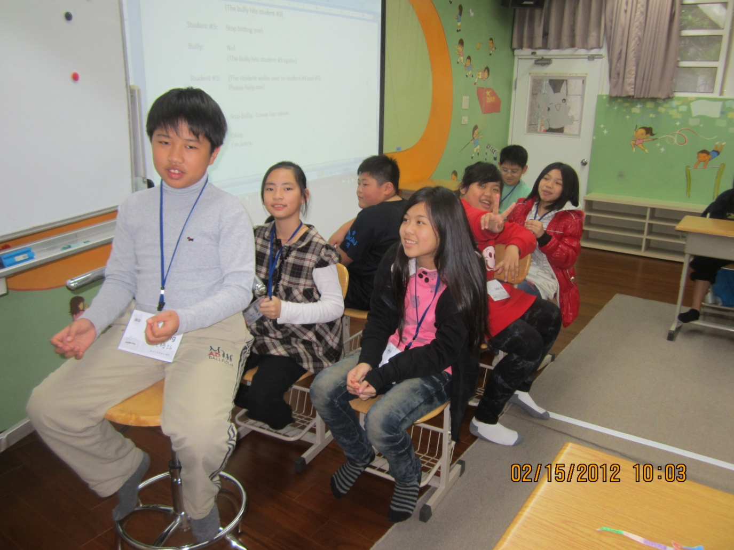
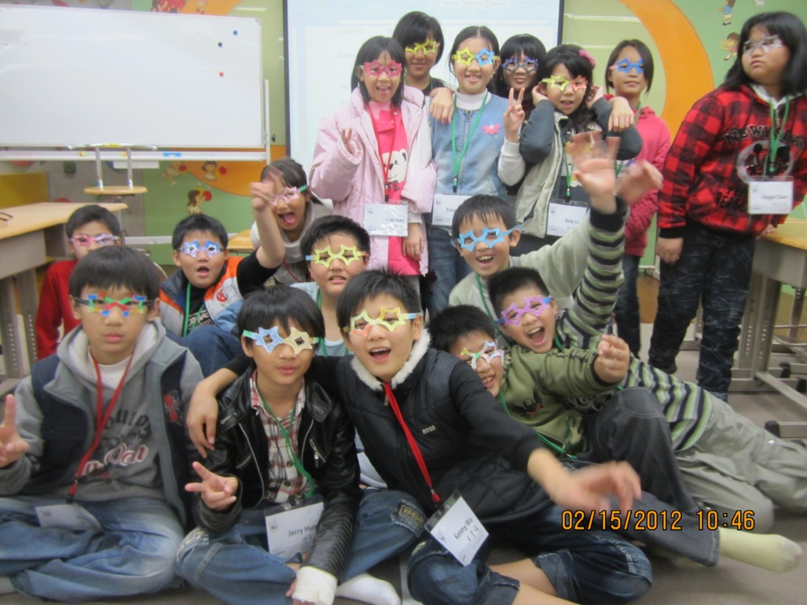
No Bullying Classes

Slide 18
Glasses Skit - Rubric
Use good English (3)
Use glasses (3)
Use microphone (3)
Use expression (3)
No looking (3)
All Students (2)

Slide 19
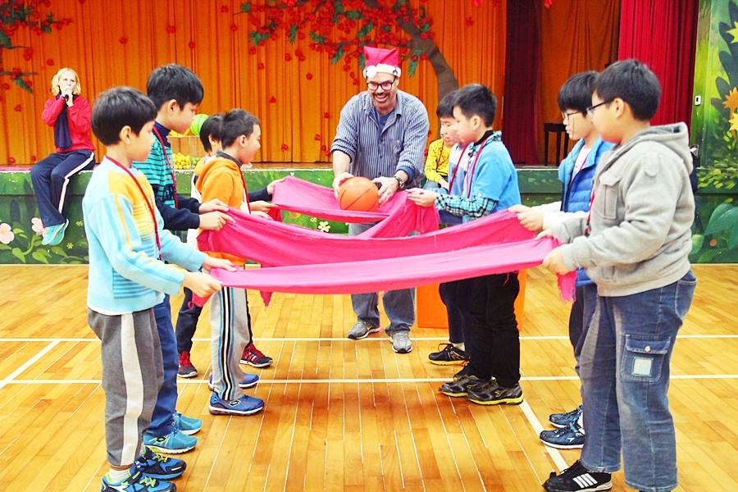
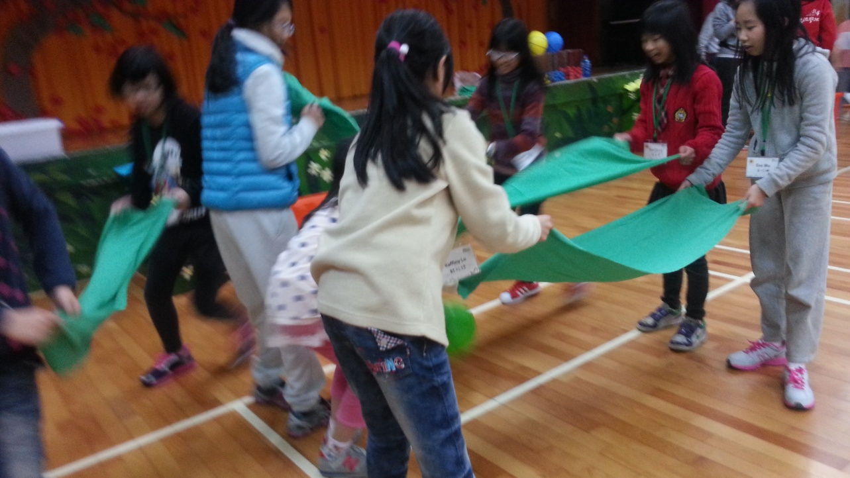
More Activities

Slide 20
Meal Song & Dinner

Slide 22
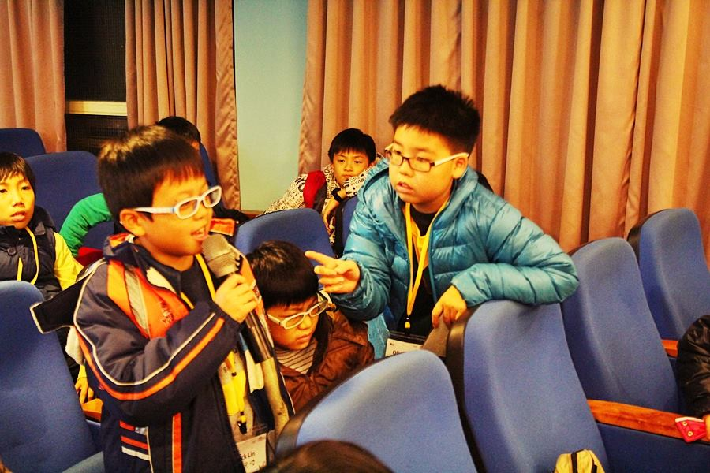
Jeopardy

Slide 23
Day 2
Morning Exercise
Morning Classes
Lunch
Afternoon Classes
Activity
Dinner
Jeopardy

Slide 24
Day 3
Fourth and Final Class
Sign name tags
Skit - On the Playground
Review homework using Website

Slide 25
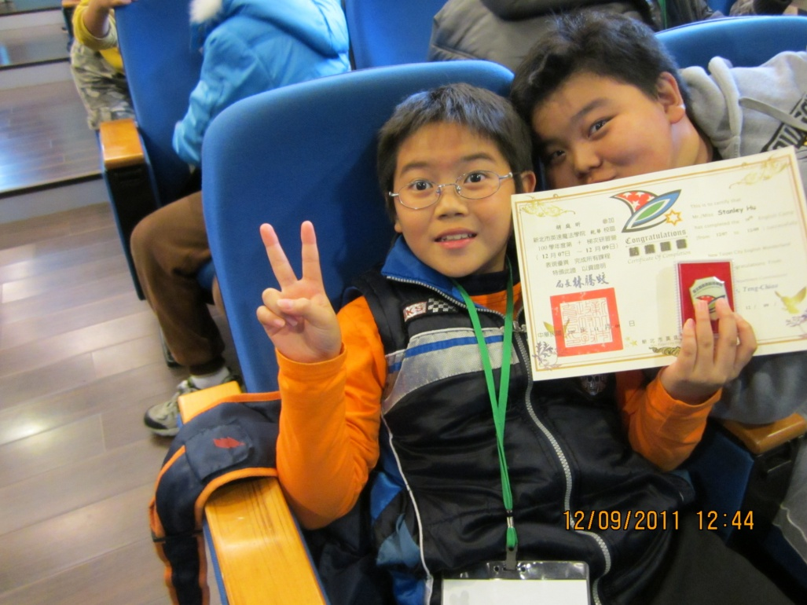
Closing

Slide 26
Teacher Responsibilities

Slide 27
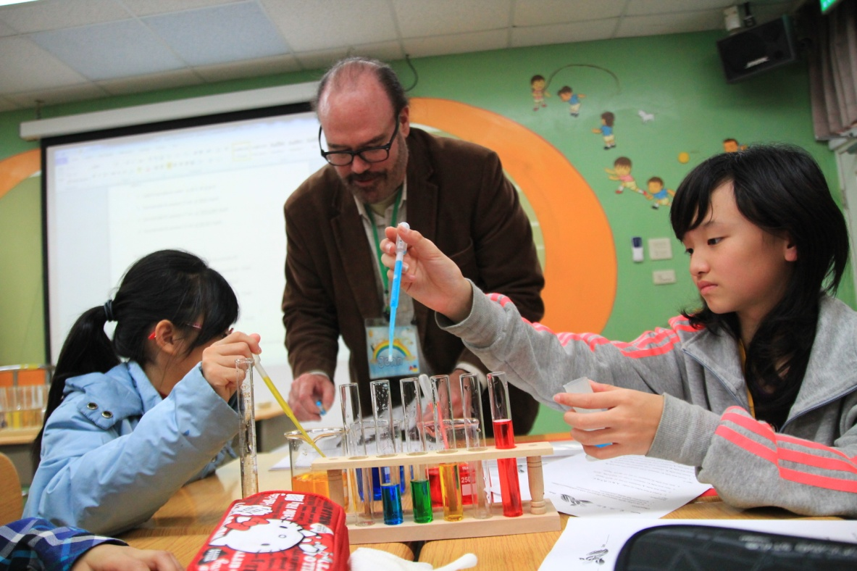
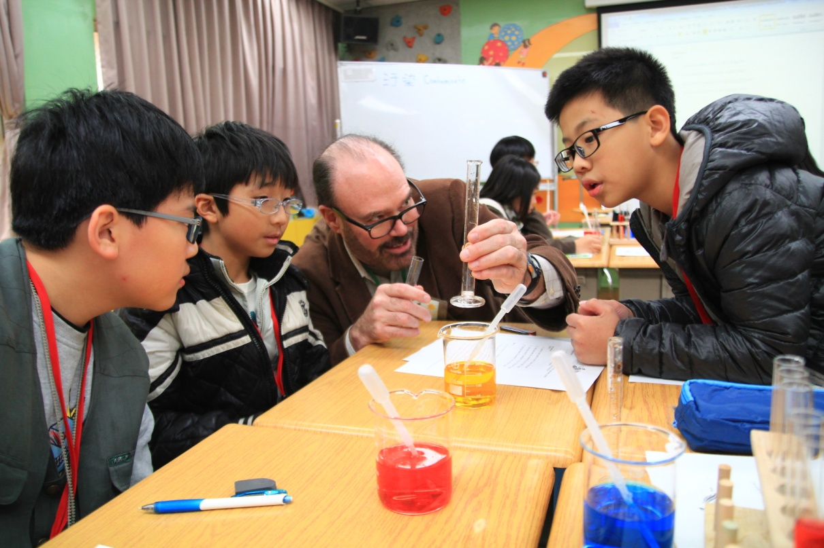
Summer/Winter Camps

Slide 28
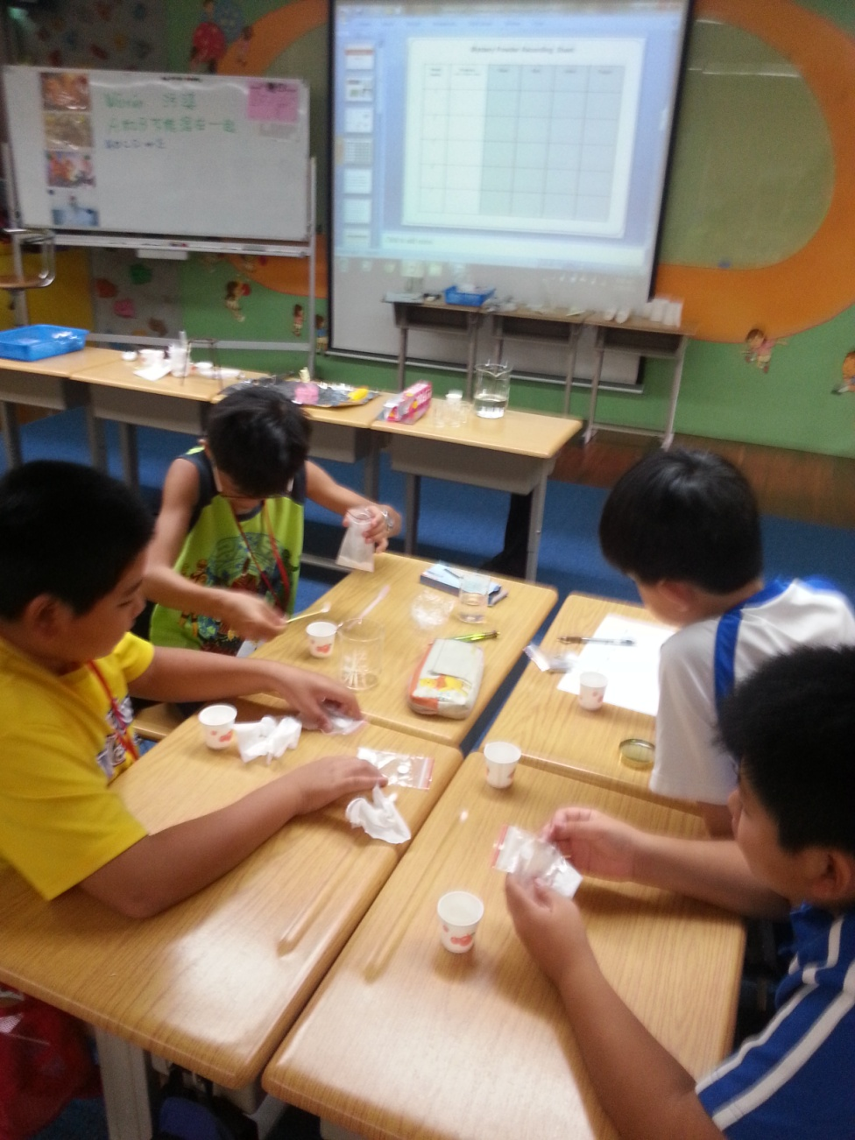
Mystery Powders

Slide 29
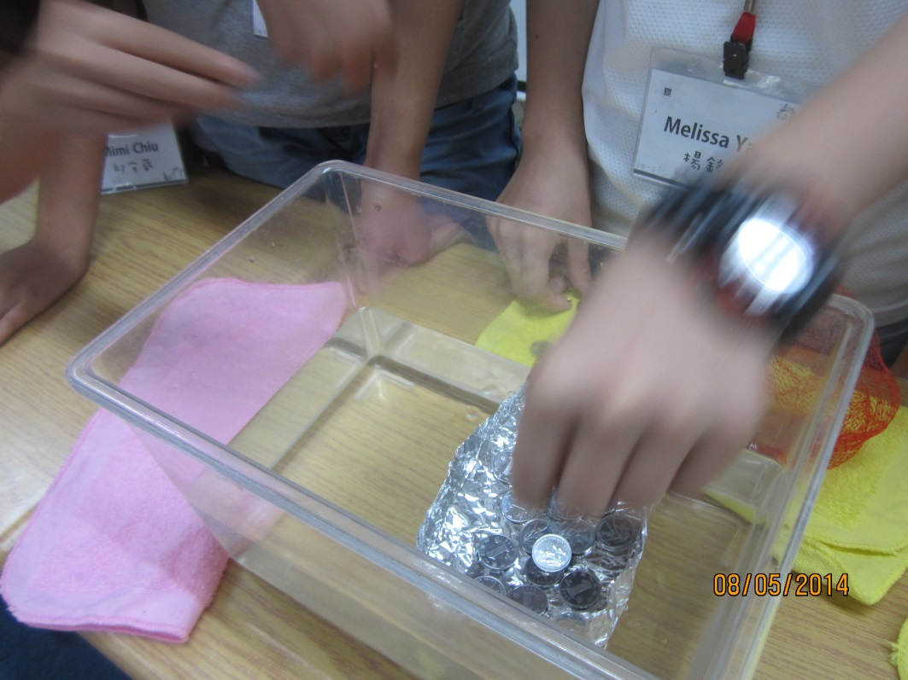
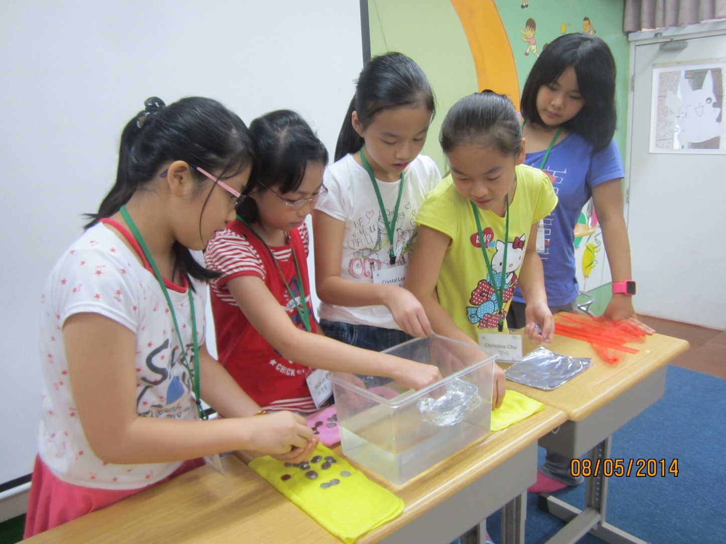
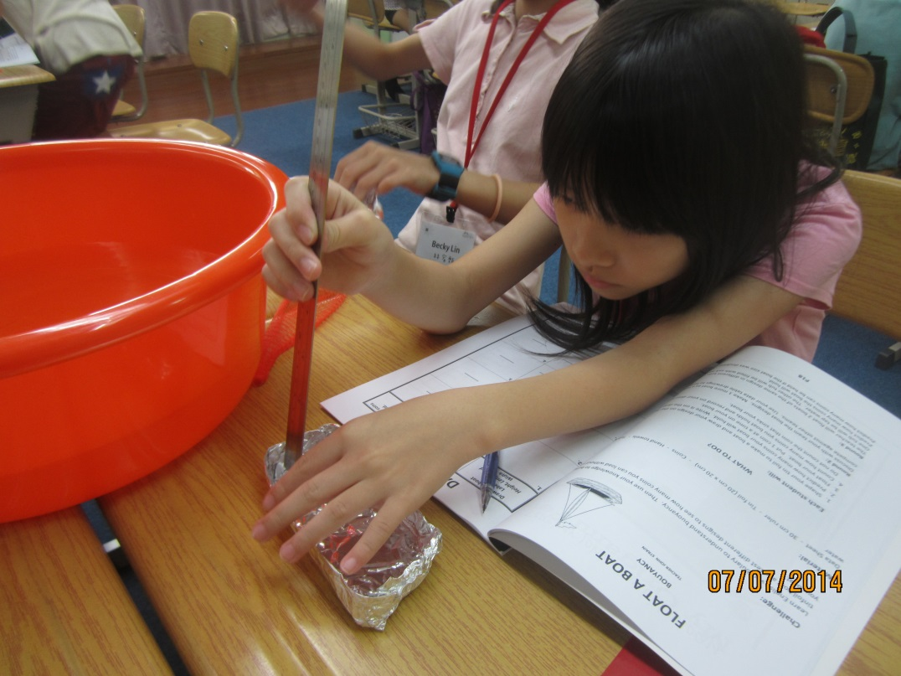
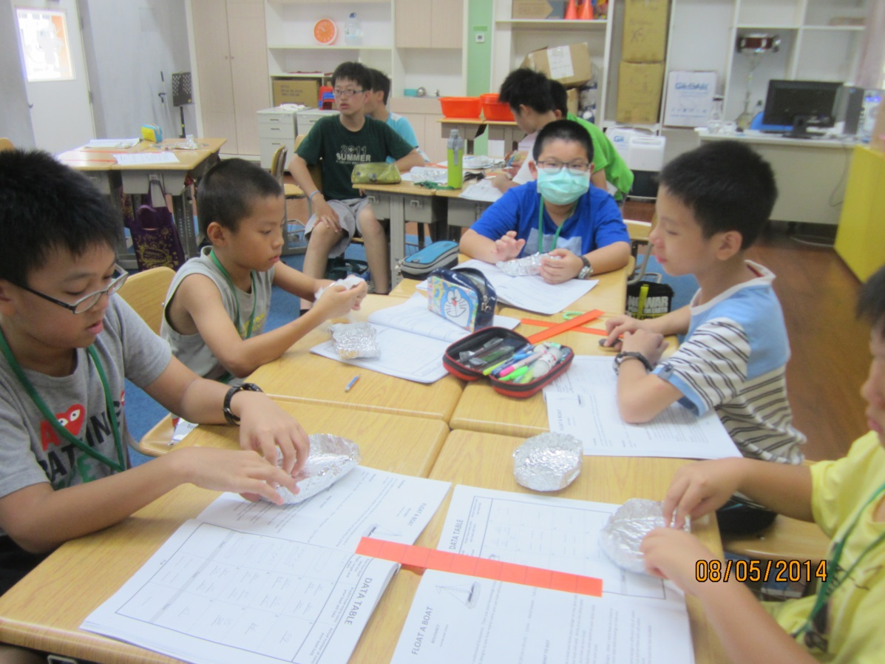
Float a Boat

Slide 30
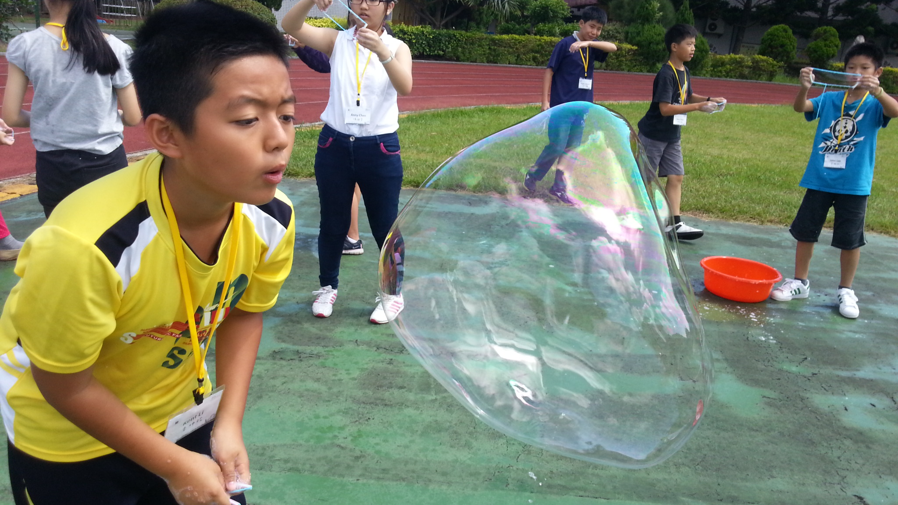
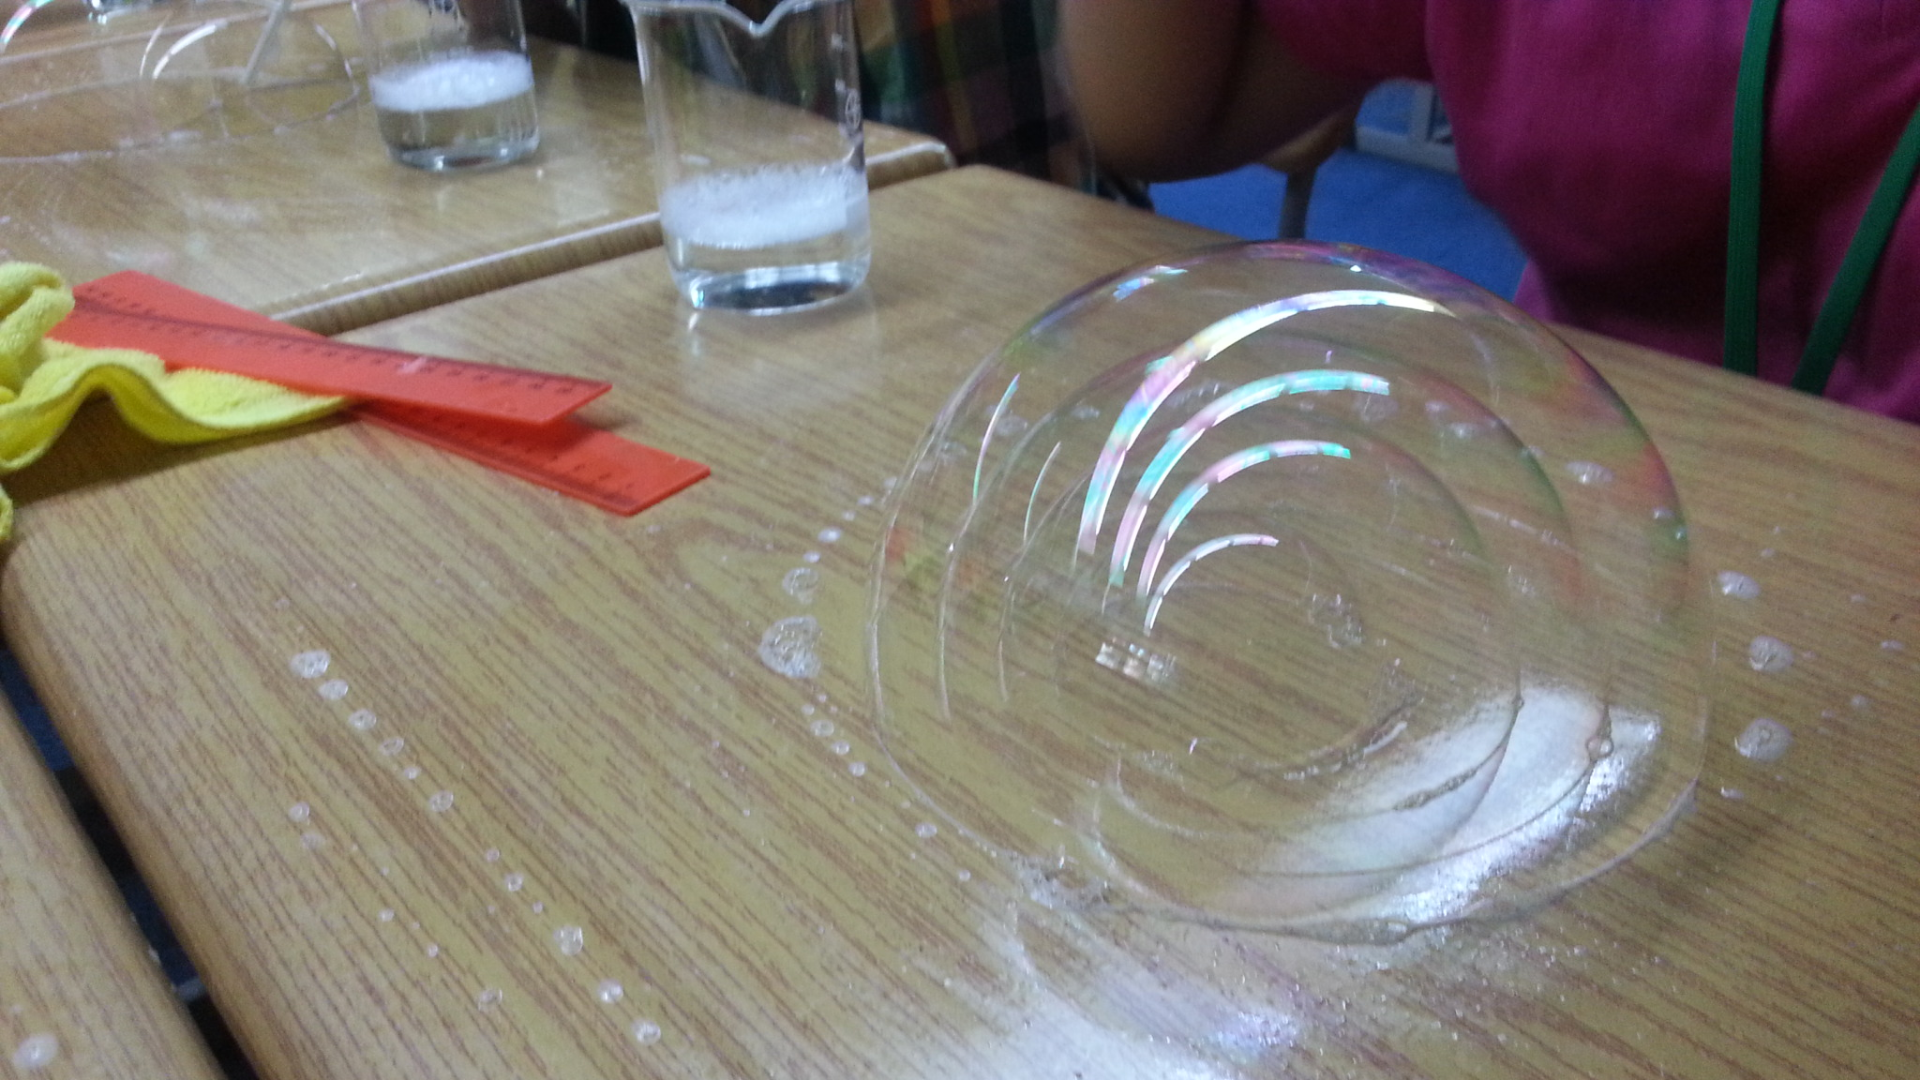
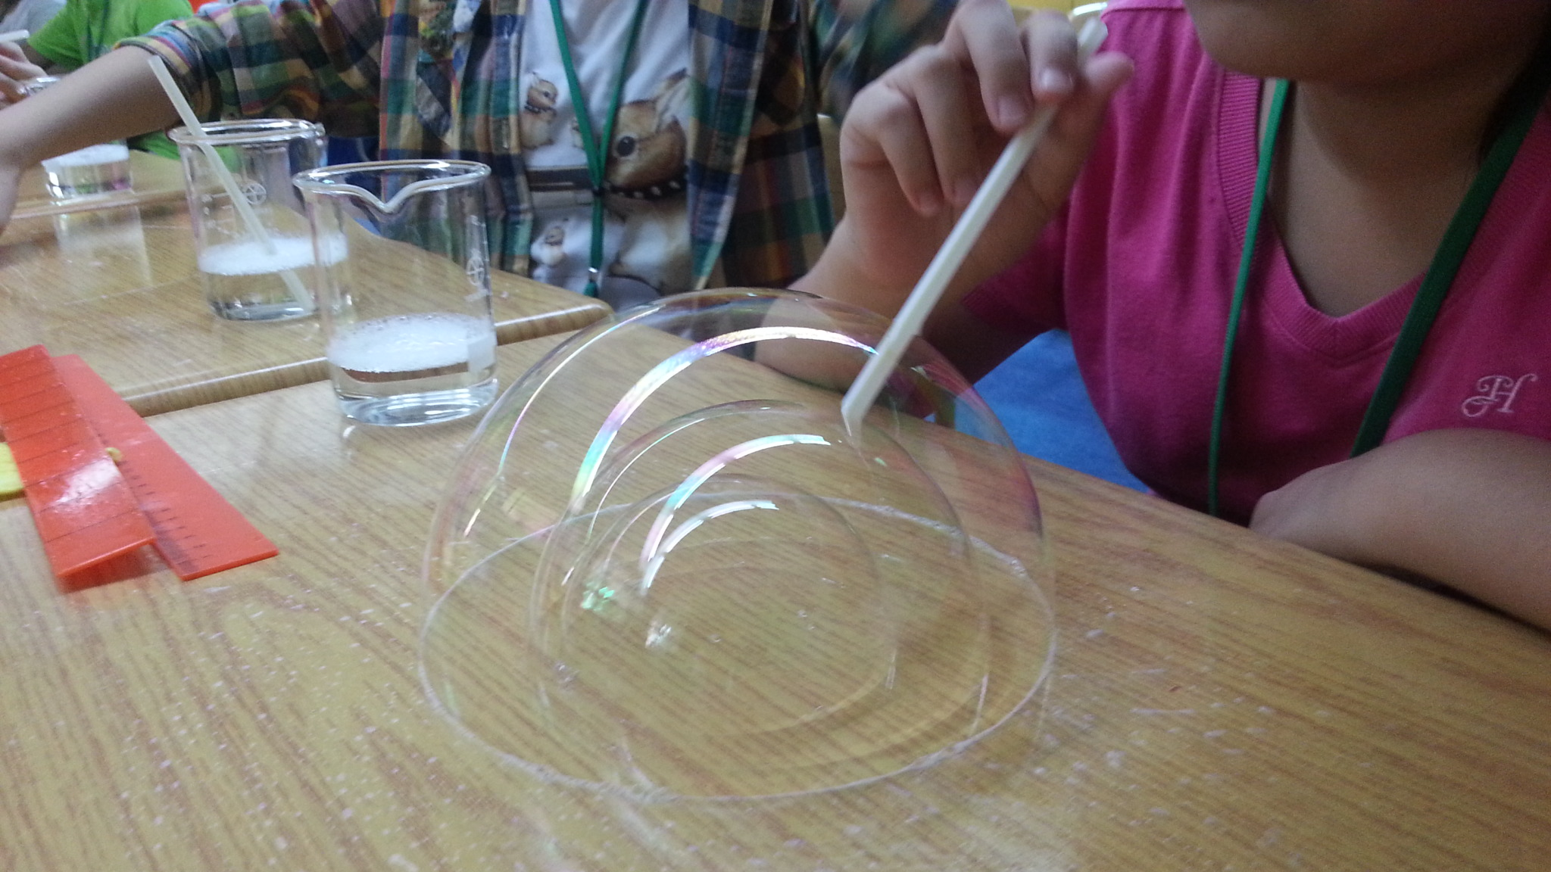
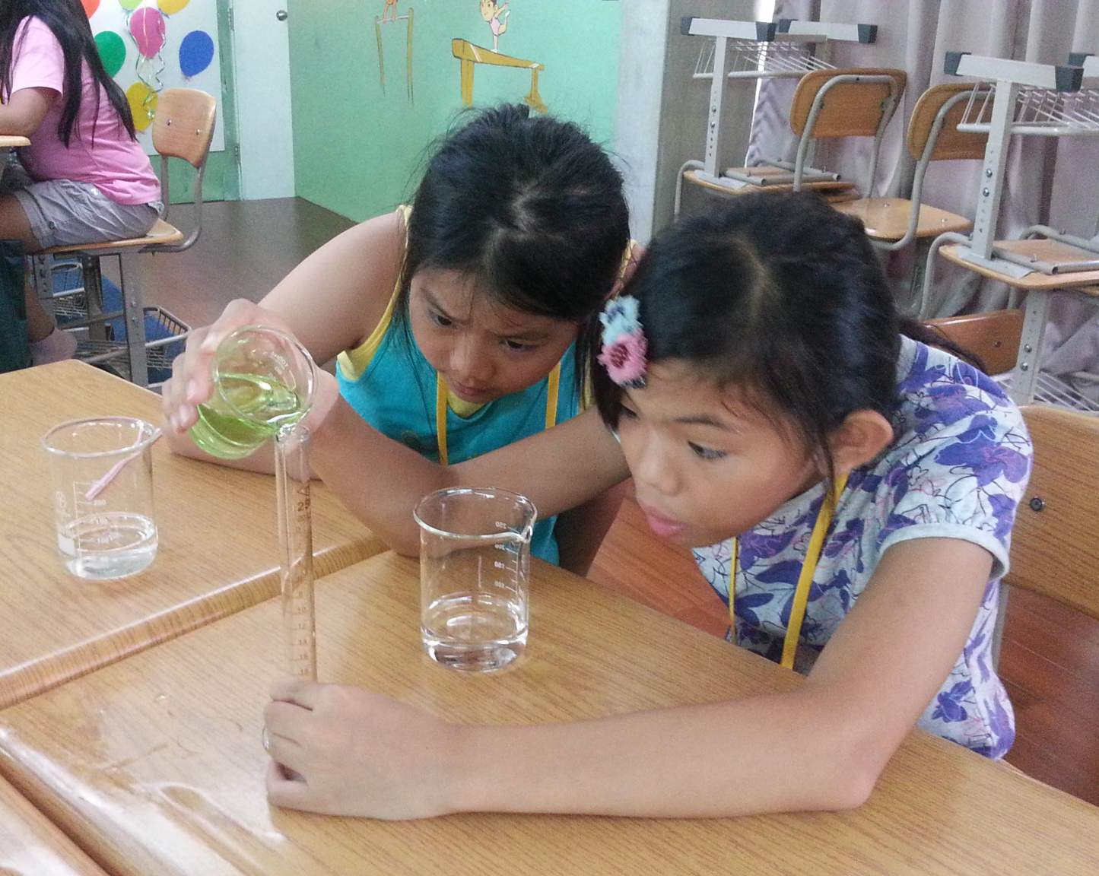
Bubbleology

Slide 31
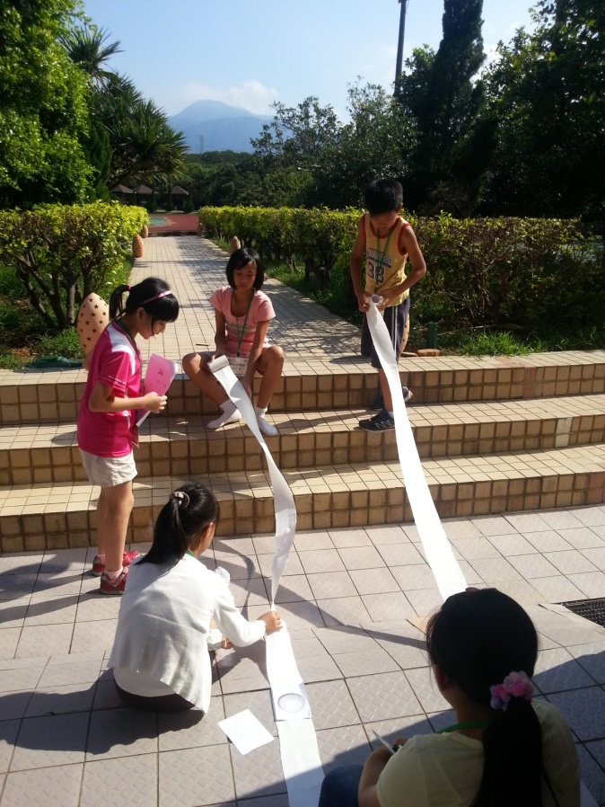
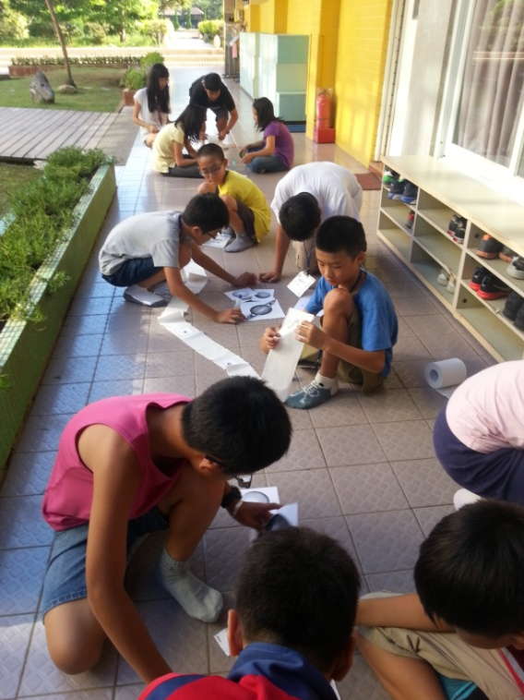
Planet Distances

Slide 32
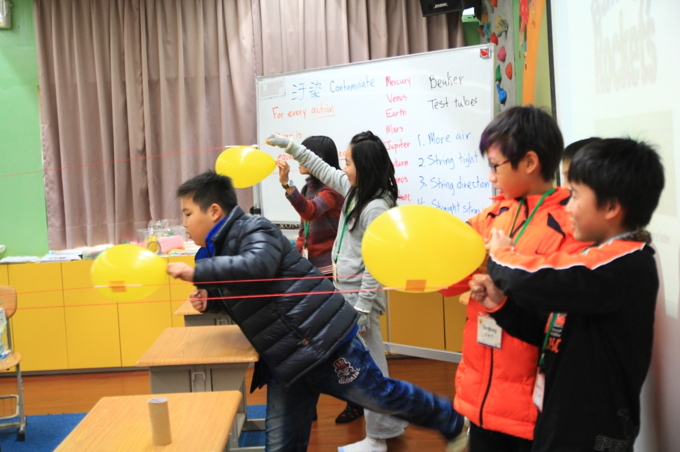
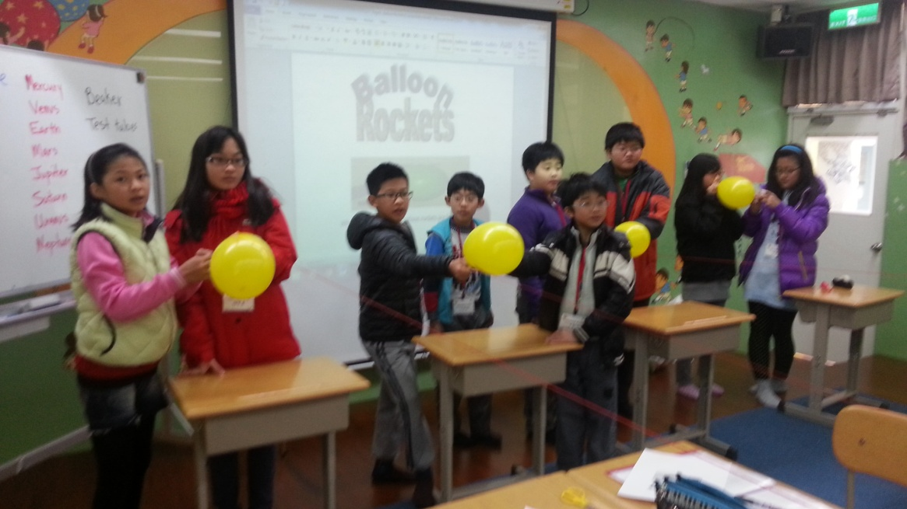
Balloon Race

Slide 33
Summer Camp

Slide 34
Summer Camp

Slide 35
Astronomy

Slide 36
www.johnlstrain.com
Questions?

